Slide 1
Tata Data Visualization: Empowering Business with Effective Insights
Prepared by:
Ayaan Dwivedi, Data Analyst
Tata Inc.

Slide 2
Table of Content
Introduction
Thought Process
Revenue by Month, 2011
Top 10 Countries by Revenue and Their Quantities
Top 10 Customers by Revenue
Revenue by Country

Slide 3


Introduction
My name is [Your Name], and today I'll be presenting the findings from our recent data analysis on [specific topic or dataset]. I will walk you through our entire process, from data loading and cleaning to the insights we've uncovered that directly address the questions you raised. Let's dive in.

Slide 4





Thought Process
To begin with, we loaded the dataset provided in Tableau, ensuring we performed a thorough data cleaning process. This included checking for any missing values, duplicates, and ensuring data consistency. By doing this, we ensured that our analysis was based on accurate and reliable data, giving us confidence in our insights

Slide 5
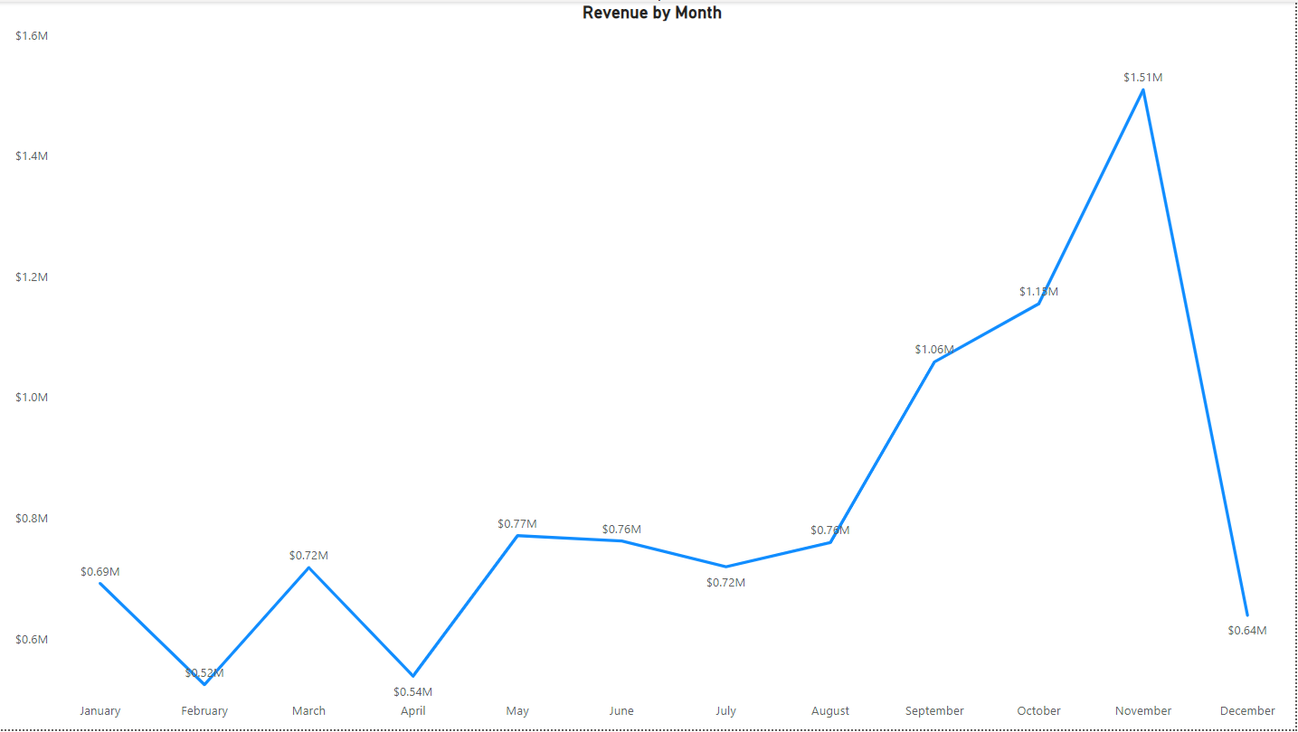
Revenue by Month, 2011
The first 8 months had stable revenues, averaging $685,000.
Revenue increased significantly from September, peaking at $1.51 million in November, demonstrating the impact of seasonality on sales

Slide 6
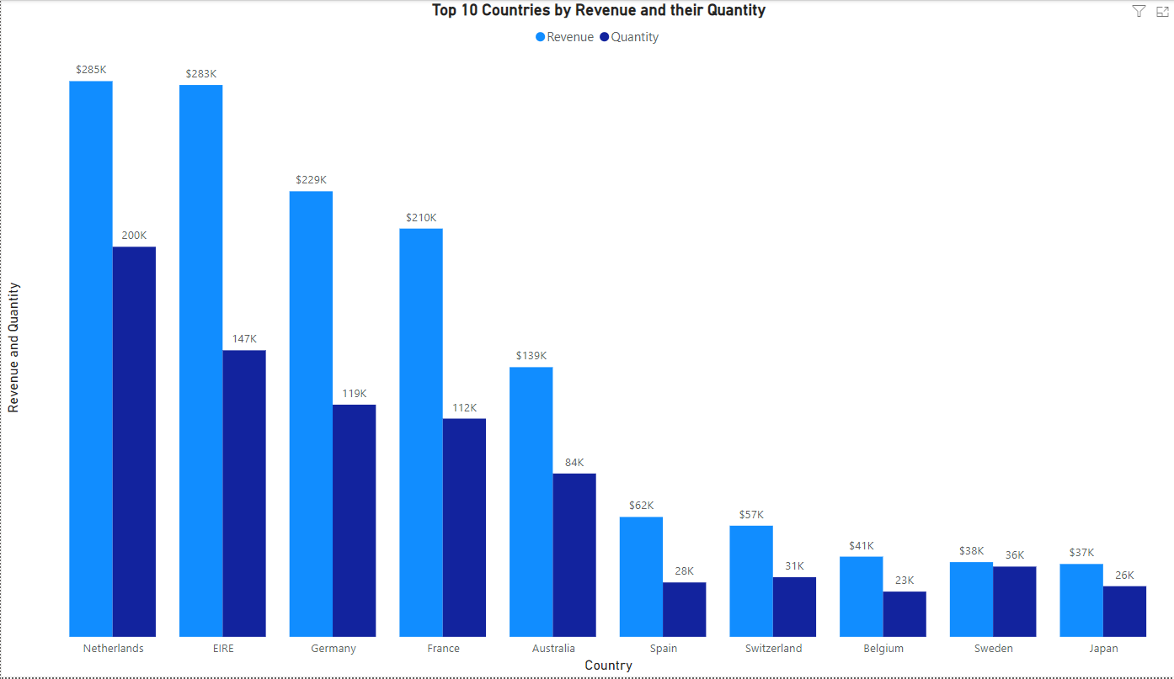
Top 10 Countries by Revenue and their Quantity
The top 10 countries by revenue and quantities indicate high purchasing power.
These countries should be the focus of our marketing strategies to maximize revenue.

Slide 7
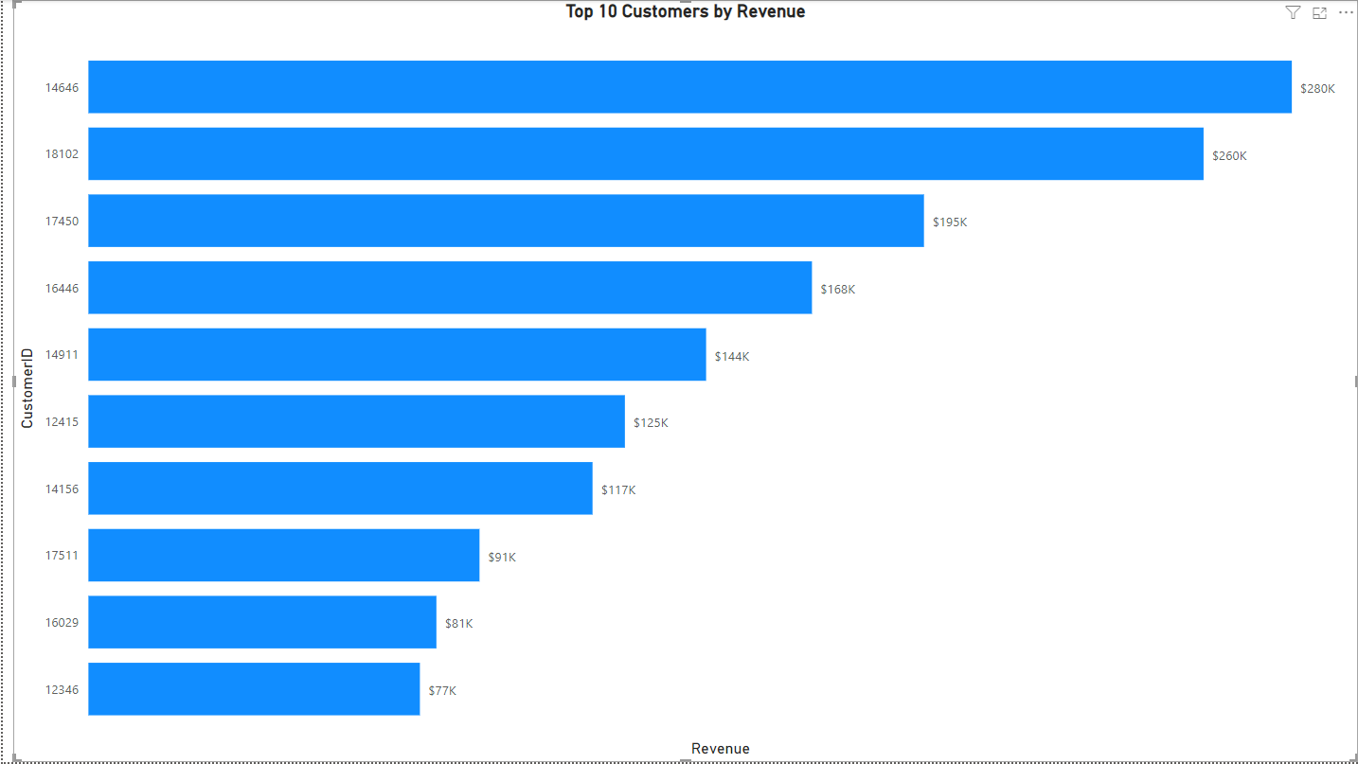
Top 10 Customers by Revenue
The chart shows that there is no major difference between the top 10 customers in terms of revenue generated.
The average difference in revenue between the top 10 customers is 15.8%.
The company can aim to strengthen the relationship with these customers to increase customer loyalty and retention, and ultimately drive more sales and revenue for the company.

Slide 8
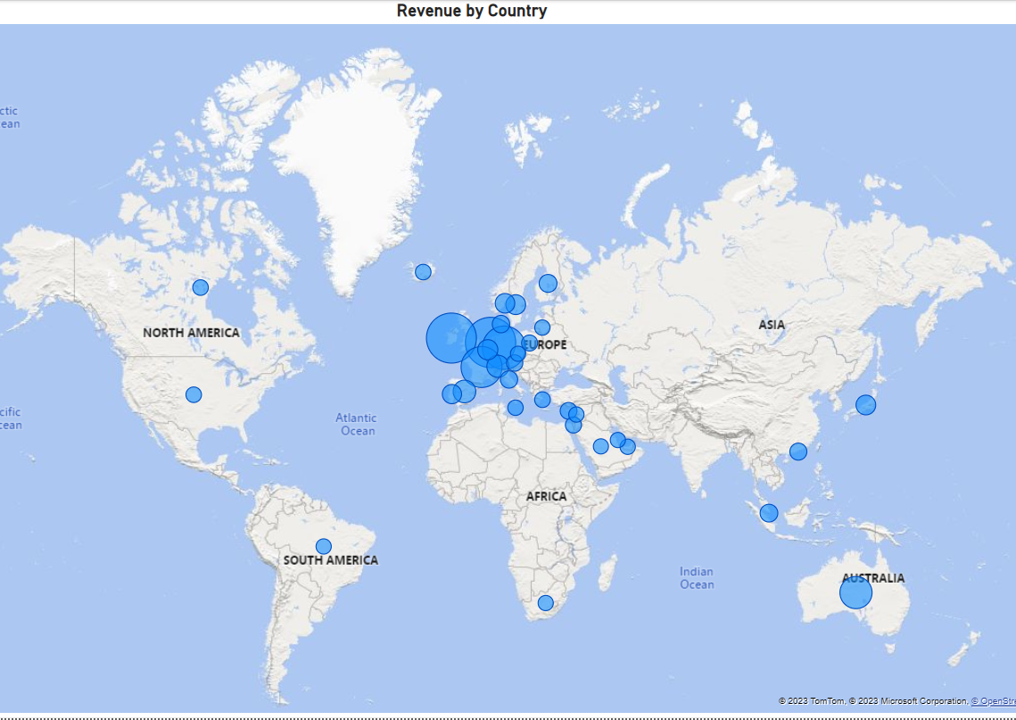
Revenue by Country
The map chart concludes by comparing the places that have produced the greatest revenue to those that have not.
The map also reveals that the majority of sales occur only in the European zone, with only a small number in the American region
Along with Russia, there is no market for the items in Africa or Asia.
The company can concentrate on the European market more and dive deeper into countries in the region to come up with strategies that will maximize sales from each country in the region alongside Australia and Japan.

Slide 9
Recommendations
When demand for certain products increases, the corporation should develop tactics to maximize sales by stockpiling and promoting seasonal products.
To develop marketing strategies for products that are often in high demand during months with poor sales, the corporation should do a more thorough examination of these products.
To inform area-specific marketing tactics, a thorough examination of the kinds of items sold in each region and the money these products bring in would be essential.
To improve relationships with its top revenue-generating clients, the business ought to think about offering incentives.
The European market presents ample opportunities for expansion, and the corporation ought to focus on tactics that will enhance its market standing inside the region.

Slide 10
THANK YOU

